Slide 1

Computer Networking CCNA 200-301

Slide 2
Course Outline
Module 1 Network Fundamentals
Explain Role and Function of Network Components : Routers, Switches, Firewall, IPs, WLC, AP, Endpoints, Servers
OSI Reference Model and TCP/ IP Model
IPv4 Addressing and Subnetting
IPv6 Addressing and IPv6 address Types
Module 2 Basic Configuration of Router and Lan Switching
Modes of Router
Basic Security of Router (Passwords) and Configuration of IP on Router
Point to Point connectivity of Routers
Configure and Verify Layer2 Discovery Protocols (CDP and LLDP)
Basic Operation of Switch (Collision Domain and Broadcast Domain)
Spanning-tree Protocol (PVST, RSTP), Port states and Port fast
Configure and Verify VLANS and Inter-switch Connectivity (Trunk ports, 802.Iq)
Ether-channel
Cisco Wireless Architecture and AP modes
Configuration of Wireless Lan Controller and AP Using GUI (WPA, WPA2, PSK)

Slide 3
Course Outline
Module 3 IP Routing
Static Routing with IPv4 and IPv6, floating static route and Default route
Configure and Verify Single area OSPF
DR and BDR election. Point to point, Concept of Router-ID
Module 4 IP Services
NAT
Configure and Verify NTP
Describe DNS, SNMP, Syslog, QOS, Function of FTP and TFPF in network
Configuration of DHCP, telnet and SSH
Describe the function of First hop redundancy protocol (HSRP, VRRP, GLBP)

Slide 4
Course Outline
Module 5 Security Fundamentals
Configure and Verify Access control List
Describe VPN Technologies (Site-to-site VPN and Remote access VPN)
Describe Authentication, Authorization and Accounting (AAA)
Configure Port Security, DHCP Snooping and Dynamic ARP Inspection
Module 6 Automation and Programmability
Explain how automation impacts network management
Compare traditional network with controller-based networking
Compare traditional campus device management with Cisco DNA Center enabled device Management.

Slide 5
Module 4 IP Services
NAT
Configure and Verify NTP
Describe DNS, SNMP, Syslog, QOS, Function of FTP and TFPF in network
Configuration of DHCP
Describe the function of First hope redundancy protocol( HSRP, VRRP, GLBP)

Slide 6
NAT
Scenario :
My company have three branches:
Lahore
Peshawar
Islamabad
Islamabad ↔ Lahore ↔ Peshawar: routers are all part of your company network.
This is an internal WAN (Wide Area Network), not the public internet.
You can use private IP addressing between these routers, and they will communicate fine because they belong to the same organization.
As long as routing protocols (like OSPF, EIGRP, BGP, etc.) or static routes are configured, your routers will exchange routes and your company traffic will flow.
This work fine , and the communication is fine
So Now what if I want to go to the internet can I go ?
Answer is no.
Going out to the internet: NAT needed

Slide 7
NAT
Why devices without NAT cannot go to the internet?
Inside a LAN, devices usually have private IP addresses (like 192.168.1.2 etc).
These private IPs are not routable on the internet ,routers on the internet will simply drop such packets.
The internet only understands public IP addresses.
So, if a computer with a private IP tries to send traffic directly to the internet:
The packet leaves the LAN.
When it reaches the first ISP router, the router sees the source IP is private.
ISP router discards the packet because private IPs are not allowed on the internet.
🔹 What solves this problem?
👉 NAT (Network Address Translation)
NAT is only needed when private IPs need to talk to the internet (public network).
You do not need NAT inside your own company network when connecting routers together.

Slide 8
NAT
NAT :
NAT stands for Network Address translation
NAT is a process that happens on a router (or firewall) which changes private IP addresses into public IP addresses and vice versa.
Allows multiple devices to share a single public IP.
Enhances security by hiding internal IPs from the internet.
Why is NAT Needed?
IPv4 address shortage.
Enables private networks to access the internet
Provides security (hides internal IPs from the outside).
Reduces the need for large public IP allocations.
NAT = a translator between your private network and the public internet.
Types of NAT:
Static NAT : One-to-one mapping between private and public IP. One public to private, one private to public.
Dynamic NAT : Private IPs are mapped to public IPs from a pool. Group public to group private, group private to group public.
PAT (Port Address Translation) : Multiple private IPs share a single public IP using different port numbers (also called NAT Overload).

Slide 9
NAT
1. Static NAT
One private IP is permanently mapped to one public IP.
Example: Hosting a web server with a fixed public IP.
Configuration example:
Router(config)# ip nat inside source static 192.168.1.10 203.0.113.10
This command creates a static mapping between a private IP address (192.168.1.10) and a public IP address (203.0.113.10).
Use case: If you're hosting a web server on your internal network and you want it to always be accessible using a fixed public IP (203.0.113.10), you'd use Static NAT.

Slide 10
NAT
2. Dynamic NAT
Private IPs are dynamically mapped to available public IPs from a pool
Requires a pool of public IPs.
Configuration example:
Router(config)# ip nat pool PUBLIC_POOL 203.0.113.20 203.0.113.30 netmask 255.255.255.0
Router(config)# ip nat inside source list 1 pool PUBLIC_POOL
First command creates a pool of public IPs (203.0.113.20 to 203.0.113.30), called PUBLIC_POOL. This pool of public IPs will be used for dynamic NAT.
Second command tells the router to map private IPs (which match the criteria in access list 1) to the public IPs in the PUBLIC_POOL.
Use case: If you have a group of internal devices that need to access the internet, but you have limited public IPs, Dynamic NAT allows the devices to share public IPs from the pool

Slide 11
NAT
3. PAT (NAT Overload)
Multiple private IPs share one public IP using different ports.
Most commonly used NAT type.
Example: Home routers use PAT to allow many devices to use one public IP.
Configuration example:
Router(config)# ip nat inside source list 1 interface GigabitEthernet0/0 overload
This command uses the overload keyword to specify that multiple internal devices can use the same public IP, but each device's traffic will be differentiated by port numbers.
For example, device 192.168.1.10 might use port 1000, and device 192.168.1.20 might use port 2000 on the same public IP address.
Use case: This is the most common NAT type used by home routers. It allows many devices (e.g., phones, laptops, etc.) inside a private network to share a single public IP for internet access. This is often seen in home networks with a single public IP.

Slide 12
NAT
3. PAT (NAT Overload)
PAT (Port Address Translation) lets many devices use one public IP address to access the internet.
It works by giving each device a unique port number so the router knows where to send the data when it comes back.
This is useful for homes and small offices because it saves public IP addresses.

Slide 13
NAT
NAT Terminology
Inside Local: Private IP address inside the network.
Inside Global: Public IP assigned to an internal device.
Outside Local: Private IP of an external device (rarely used).
Outside Global: Public IP of an external device

Slide 14
NAT
NAT Terminology
Inside Local: Private IP address inside the network.
This is the private IP address of a device inside your network.
A computer on your internal network might have an IP address like 192.168.1.10. This is its Inside Local IP.
These private IPs are not directly visible on the internet.
Inside Global: Public IP assigned to an internal device.
This is the public IP address that is assigned to a device inside your network when it accesses the internet.
When your internal device (192.168.1.10) communicates with the internet, the router will translate it into a public IP like 203.0.113.10 (this is the Inside Global IP).
The Inside Global IP allows the internal device to communicate with external servers (like websites) on the internet.

Slide 15
NAT
NAT Terminology
Outside Local: Private IP of an external device (rarely used).
This refers to the private IP address of a device located outside your network.
Imagine you're trying to access a server on another private network with a private IP like 10.0.0.5. This is the Outside Local IP.
This IP is rarely used in regular internet communication, but it can appear if you're dealing with another private network.
Outside Global: Public IP of an external device
This is the public IP address of a device located outside your network.
When you visit a website, the website's server will have a public IP like 198.51.100.5. This is the Outside Global IP.
This public IP allows the external device (the server hosting the website) to be accessible from anywhere on the internet.

Slide 16
NAT
NAT Terminology Simple Example:
Your home network has a private IP range (e.g., 192.168.1.x).
Inside Local: A device inside your network, like your laptop, has an IP like 192.168.1.10.
Inside Global: When your laptop accesses the internet, your router translates it into a public IP (like 203.0.113.10).
Outside Global: The website you visit has a public IP (e.g., 198.51.100.5).
Outside Local: The website’s server may have a private IP (e.g., 10.0.0.5), but you typically don’t deal with this directly.
Advantages & Disadvantages of NAT:
Conserves public IP addresses.
Provides security by hiding internal IPs.
Enables private network connectivity to the internet.

Slide 17
Static NAT Configuration

Slide 18
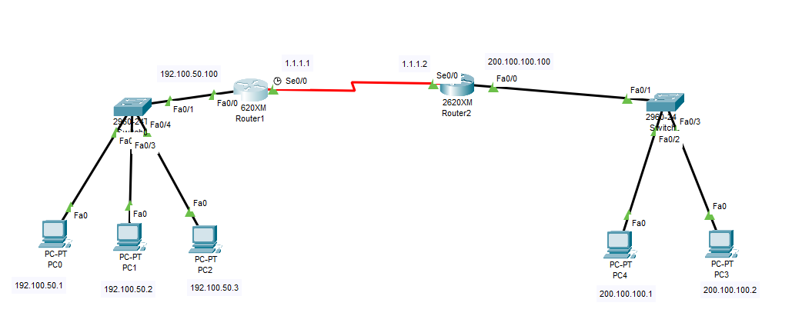
Static NAT Configuration
Network Diagram
Steps to Apply static NAT:
First, we need to do basic configuration, Configure routing protocol static or dynamic
Define NAT
Implement NAT at interface level

Slide 19
Static NAT Configuration
Configuration:
R1
R1(config)# interface fa0/0
R1(config-if)# ip address 192.100.50.100 255.255.255.0
R1(config-if)# no shutdown
R1(config-if)# exit
R1(config)# interface s0/0
R1(config-if)# ip address 1.1.1.1 255.0.0.0
R1(config-if)# no shutdown
R1(config-if)# exit
R1(config)# router rip
R1(config)# network 192.100.50.0
R1(config)# network 1.0.0.0
R1(config-if)# exit
R2
R2(config)# interface fa0/0
R2(config-if)# ip address 200.100.100.100 255.255.255.0
R2(config-if)# no shutdown
R2(config-if)# exit
R2(config)# interface s0/0
R2(config-if)# ip address 1.1.1.2 255.0.0.0
R2(config-if)# no shutdown
R2(config-if)# exit
R2(config)# router rip
R2(config)# network 200.100.100.0
R2(config)# network 1.0.0.0
R2(config-if)# exit

Slide 20
Static NAT Configuration
Configuration:
Define NAT inside & outside interfaces
R1(config)# interface fa0/0
R1(config-if)# ip nat inside
R1(config-if)# exit
R1(config)# interface s0/0
R1(config-if)# ip nat outside
R1(config-if)# exit
Configure Static NAT Mappings
R1(config)# ip nat inside source static 192.100.50.1 1.1.1.10
R1(config)# ip nat inside source static 192.100.50.2 1.1.1.11
R1(config)# ip nat inside source static 192.100.50.3 1.1.1.12
R1# show ip nat translations Result

Slide 21
Static NAT Configuration
Configuration Summary:
R1
R1(config)# interface fa0/0
R1(config-if)# ip address 192.100.50.100 255.255.255.0
R1(config-if)# no shutdown
R1(config-if)# exit
R1(config)# interface s0/0
R1(config-if)# ip address 1.1.1.1 255.0.0.0
R1(config-if)# no shutdown
R1(config-if)# exit
R1(config)# router rip
R1(config)# network 192.100.50.0
R1(config)# network 1.0.0.0
R1(config-if)# exit
NAT Configuration
R1(config)# interface fa0/0
R1(config-if)# ip nat inside
R1(config-if)# exit
R1(config)# interface s0/0
R1(config-if)# ip nat outside
R1(config-if)# exit
R1(config)# ip nat inside source static 192.100.50.1 210.10.10.1
R1(config)# ip nat inside source static 192.100.50.2 210.10.10.2
R1(config)# ip nat inside source static 192.100.50.3 210.10.10.3
R2
R2(config)# interface fa0/0
R2(config-if)# ip address 200.100.100.100 255.255.255.0
R2(config-if)# no shutdown
R2(config-if)# exit
R2(config)# interface s0/0
R2(config-if)# ip address 1.1.1.2 255.0.0.0
R2(config-if)# no shutdown
R2(config-if)# exit
R2(config)# router rip
R2(config)# network 200.100.100.0
R2(config)# network 1.0.0.0
R2(config-if)# exit
R1# show ip nat translations Result

Slide 22
Static NAT Configuration
Step-by-Step Explanation of NAT Process
Your internal device (192.100.50.1) wants to access the internet.
              Let's say PC1 (192.100.50.1) wants to visit google.com.
Static NAT translates 192.100.50.1 → 1.1.1.10
The NAT rule you configured on R1 (ip nat inside source static 192.100.50.1 1.1.1.10) ensures that any outgoing traffic from 192.100.50.1 is translated to 1.1.1.10.
1.1.1.10 sends traffic to the internet via 1.1.1.1
After translation, the packet now has a source IP of 1.1.1.10.
This packet is then routed out of R1's serial interface (s0/0), which has IP 1.1.1.1.
The ISP router (R2) receives the packet at 1.1.1.2 and forwards it to the internet.
Response comes back from the internet
When Google responds, it sends a packet back to 1.1.1.10 (the translated public IP).
The ISP routes this packet to R1 (since it knows R1 handles 1.1.1.x).
R1 translates 1.1.1.10 → 192.100.50.1
Before sending the packet to PC1, R1 reverses the NAT translation.
The packet now has a destination IP of 192.100.50.1 and is forwarded to PC1.

Slide 23
Static NAT Configuration
Summary:
Your internal IP 192.100.50.1 is translated to 1.1.1.10 using Static NAT.
This translated IP (1.1.1.10) communicates with the internet via 1.1.1.1 (R1's WAN interface).
The response follows the same path in reverse, with R1 translating 1.1.1.10 back to 192.100.50.1.
Important things to note :
The outside world (ISP and beyond) can only send packets to IPs that are routable back to you.
That means the public IPs you use in NAT must come from the block your ISP has routed towards your WAN interface.
If you use some random IP (like 210.10.10.x in your first try)
The ISP (R2 in your lab) has no route for it.
So, return traffic never comes back → communication fails.
In real life: Always use the WAN IP range your ISP gives you (could be just one IP, or a block

Slide 24
Dynamic NAT Configuration
Using the Serial Interface's IP (Recommended for Simplicity)

Slide 25
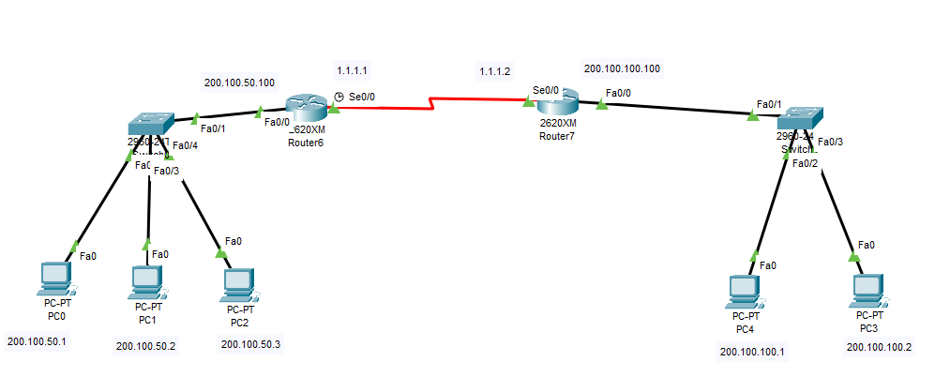
Dynamic NAT Configuration
Network Diagram
Steps to Apply Dynamic NAT:
First, we need to do basic configuration, Configure routing protocol static or dynamic
Access List
Define Pool & Pool Name
Map Private IPs to Public Pool
Implement NAT at interface level

Slide 26
Dynamic NAT Configuration
Configuration:
R1
R1(config)# interface fa0/0
R1(config-if)# ip address 200.100.50.100 255.255.255.0
R1(config-if)# no shutdown
R1(config-if)# exit
R1(config)# interface s0/0
R1(config-if)# ip address 1.1.1.1 255.0.0.0
R1(config-if)# no shutdown
R1(config-if)# exit
R1(config)# router rip
R1(config)# network 200.100.50.0
R1(config)# network 1.0.0.0
R1(config-if)# exit
R2
R2(config)# interface fa0/0
R2(config-if)# ip address 200.100.100.100 255.255.255.0
R2(config-if)# no shutdown
R2(config-if)# exit
R2(config)# interface s0/0
R2(config-if)# ip address 1.1.1.2 255.0.0.0
R2(config-if)# no shutdown
R2(config-if)# exit
R2(config)# router rip
R2(config)# network 200.100.100.0
R2(config)# network 1.0.0.0
R2(config-if)# exit

Slide 27
Dynamic NAT Configuration
Configuration:
Define Access List for Inside Network
access-list 3 permit 200.100.50.0 0.0.0.255
This defines which inside IPs are allowed to be translated
Define NAT Pool for Public IPs
ip nat pool CCNA 1.1.1.3 1.1.1.254 netmask 255.0.0.0
This creates the range of Public IPs that will be used for translation
Map Private IPs to Public Pool
ip nat inside source list 3 pool CCNA
This connect the access list (Private IPs) to the NAT Pool (Public IPs)
Implement NAT at interface level
R1(config)# interface fa0/0
R1(config-if)# ip nat inside
R1(config-if)# exit
R1(config)# interface s0/0
R1(config-if)# ip nat outside
R1(config-if)# exit

Slide 28
Dynamic NAT Configuration
Configuration Summary:
R1
R1(config)# interface fa0/0
R1(config-if)# ip address 200.100.50.100 255.255.255.0
R1(config-if)# no shutdown
R1(config-if)# exit
R1(config)# interface s0/0
R1(config-if)# ip address 1.1.1.1 255.0.0.0
R1(config-if)# no shutdown
R1(config-if)# exit
R1(config)# router rip
R1(config)# network 200.100.50.0
R1(config)# network 1.0.0.0
R1(config-if)# exit
NAT Configuration
R1(config)# ip nat pool CCNA 1.1.1.3 1.1.1.254 netmask 255.0.0.0
R1(config)# ip nat inside source list 3 pool CCNA
R1(config)# access-list 3 permit 200.100.50.0 0.0.0.255
R1(config)# interface fa0/0
R1(config-if)# ip nat inside
R1(config-if)# exit
R1(config)# interface s0/0
R1(config-if)# ip nat outside
R1(config-if)# exit
R2
R2(config)# interface fa0/0
R2(config-if)# ip address 200.100.100.100 255.255.255.0
R2(config-if)# no shutdown
R2(config-if)# exit
R2(config)# interface s0/0
R2(config-if)# ip address 1.1.1.1 255.0.0.0
R2(config-if)# no shutdown
R2(config-if)# exit
R2(config)# router rip
R2(config)# network 200.100.100.0
R2(config)# network 1.0.0.0
R2(config-if)# exit
R1# show ip nat translations Result

Slide 29
Dynamic NAT Configuration
Using a NAT Pool (Custom Public IP Range)

Slide 30
Dynamic NAT Configuration
Network Diagram
Steps to Apply Dynamic NAT:
First, we need to do basic configuration, Configure routing protocol static or dynamic
Define Pool, Pool Name, Access List
Implement NAT at interface level

Slide 31
Dynamic NAT Configuration
Configuration:
R1
R1(config)# interface fa0/0
R1(config-if)# ip address 200.100.50.100 255.255.255.0
R1(config-if)# no shutdown
R1(config-if)# exit
R1(config)# interface s0/0
R1(config-if)# ip address 1.1.1.1 255.0.0.0
R1(config-if)# no shutdown
R1(config-if)# exit
R1(config)# router rip
R1(config)# network 200.100.50.0
R1(config)# network 1.0.0.0
R1(config-if)# exit
R2
R2(config)# interface fa0/0
R2(config-if)# ip address 200.100.100.100 255.255.255.0
R2(config-if)# no shutdown
R2(config-if)# exit
R2(config)# interface s0/0
R2(config-if)# ip address 1.1.1.2 255.0.0.0
R2(config-if)# no shutdown
R2(config-if)# exit
R2(config)# router rip
R2(config)# network 200.100.100.0
R2(config)# network 1.0.0.0
R2(config-if)# exit

Slide 32
Dynamic NAT Configuration
Configuration:
Define NAT Pool for Public IPs
R1(config)# ip nat pool CCNA 210.10.10.1 210.10.10.5 netmask 255.255.255.0
Map Private IPs to Public Pool
R1(config)# ip nat inside source list 3 pool CCNA
Define Access List for Inside Network
R1(config)# access-list 3 permit 200.100.50.0 0.0.0.255
Define NAT inside & outside interfaces
R1(config)# interface fa0/0
R1(config-if)# ip nat inside
R1(config-if)# exit
R1(config)# interface s0/0
R1(config-if)# ip nat outside
R1(config-if)# exit

Slide 33
Dynamic NAT Configuration
Configuration Summary:
R1
R1(config)# interface fa0/0
R1(config-if)# ip address 200.100.50.100 255.255.255.0
R1(config-if)# no shutdown
R1(config-if)# exit
R1(config)# interface s0/0
R1(config-if)# ip address 1.1.1.1 255.0.0.0
R1(config-if)# no shutdown
R1(config-if)# exit
R1(config)# router rip
R1(config)# network 200.100.50.0
R1(config)# network 1.0.0.0
R1(config-if)# exit
NAT Configuration
R1(config)# ip nat pool CCNA 210.10.10.1 210.10.10.5 netmask 255.255.255.0
R1(config)# ip nat inside source list 3 pool CCNA
R1(config)# access-list 3 permit 200.100.50.0 0.0.0.255
R1(config)# interface fa0/0
R1(config-if)# ip nat inside
R1(config-if)# exit
R1(config)# interface s0/0
R1(config-if)# ip nat outside
R1(config-if)# exit
R2
R2(config)# interface fa0/0
R2(config-if)# ip address 200.100.100.100 255.255.255.0
R2(config-if)# no shutdown
R2(config-if)# exit
R2(config)# interface s0/0
R2(config-if)# ip address 1.1.1.1 255.0.0.0
R2(config-if)# no shutdown
R2(config-if)# exit
R2(config)# router rip
R2(config)# network 200.100.100.0
R2(config)# network 1.0.0.0
R2(config-if)# exit
R1# show ip nat translations Result

Slide 34
PAT (Port Address Translation)

Slide 35
PAT (Port Address Translation)
Network Diagram
Steps to Apply PAT (Port Address Translation) :
Basic configuration
Define Access Control List (ACL)
Configure (PAT) at the interface level

Slide 36
PAT (Port Address Translation)
Configuration:
R1
R1(config)# interface fa0/0
R1(config-if)# ip address 200.100.50.100 255.255.255.0
R1(config-if)# no shutdown
R1(config-if)# exit
R1(config)# interface s0/0
R1(config-if)# ip address 1.1.1.1 255.0.0.0
R1(config-if)# no shutdown
R1(config-if)# exit
R1(config)# router rip
R1(config)# network 200.100.50.0
R1(config)# network 1.0.0.0
R1(config-if)# exit
R2
R2(config)# interface fa0/0
R2(config-if)# ip address 200.100.100.100 255.255.255.0
R2(config-if)# no shutdown
R2(config-if)# exit
R2(config)# interface s0/0
R2(config-if)# ip address 1.1.1.2 255.0.0.0
R2(config-if)# no shutdown
R2(config-if)# exit
R2(config)# router rip
R2(config)# network 200.100.100.0
R2(config)# network 1.0.0.0
R2(config-if)# exit

Slide 37
PAT (Port Address Translation)
Configuration:
Define Access List for Inside Network
R1(config)# access-list 3 permit 200.100.50.0 0.0.0.255
This command is used to select all IPs in the 200.100.50.0/24 network for NAT.
NAT Overload (PAT) Configuration
R1(config)# ip nat inside source list 3 interface s0/0 overload
This command is used to translate all IPs permitted in ACL 3 into the public IP of interface s0/0 using PAT (overload) so multiple devices can share one public IP.
Define NAT inside & outside interfaces
R1(config)# interface fa0/0
R1(config-if)# ip nat inside
R1(config-if)# exit
R1(config)# interface s0/0
R1(config-if)# ip nat outside
R1(config-if)# exit

Slide 38
PAT (Port Address Translation)
Configuration Summary:
R1
R1(config)# interface fa0/0
R1(config-if)# ip address 200.100.50.100 255.255.255.0
R1(config-if)# no shutdown
R1(config-if)# exit
R1(config)# interface s0/0
R1(config-if)# ip address 1.1.1.1 255.0.0.0
R1(config-if)# no shutdown
R1(config-if)# exit
R1(config)# router rip
R1(config)# network 200.100.50.0
R1(config)# network 1.0.0.0
R1(config-if)# exit
NAT Configuration
R1(config)# access-list 3 permit 200.100.50.0 0.0.0.255
R1(config)# ip nat inside source list 3 interface s0/0 overload
R1(config)# interface fa0/0
R1(config-if)# ip nat inside
R1(config-if)# exit
R1(config)# interface s0/0
R1(config-if)# ip nat outside
R1(config-if)# exit
R2
R2(config)# interface fa0/0
R2(config-if)# ip address 200.100.100.100 255.255.255.0
R2(config-if)# no shutdown
R2(config-if)# exit
R2(config)# interface s0/0
R2(config-if)# ip address 1.1.1.1 255.0.0.0
R2(config-if)# no shutdown
R2(config-if)# exit
R2(config)# router rip
R2(config)# network 200.100.100.0
R2(config)# network 1.0.0.0
R2(config-if)# exit
R1# show ip nat translations Result

Slide 39
PAT (Port Address Translation)
Configuration Summary:
In PAT, we don't need the ip nat pool command because it uses a single public IP address (usually the interface IP) for all internal devices, differentiating them by port numbers. The overload option allows multiple internal devices to share the same public IP, so a pool of IP addresses is not required.

Slide 40
NTP (Network Time Protocol)
What is NTP?
NTP (Network Time Protocol) is used to synchronize the time of network devices to a reference time source.
What is the Purpose of an NTP Server?
An NTP (Network Time Protocol) server ensures that all devices in a network have accurate and synchronized time. This is important for:
✅ Logging & Security – Accurate timestamps are crucial for tracking events in logs (e.g., system logs, security logs).
✅ Network Coordination – Many network protocols (e.g., authentication, file transfers) rely on synchronized time.
✅ Avoiding Errors – Some applications may fail if the time is not synchronized across devices.

Slide 41
NTP (Network Time Protocol)
How NTP works in Cisco routers?
One device (R1) acts as the NTP Server (time source).
The other routers (R2, R3, R4) can be configured as NTP Clients.
If you configure R1 as the NTP Master (Server) and configure R2, R3, R4 as NTP Clients pointing to R1:
✅ All routers will get the correct time from R1 (if they have IP connectivity).
If you configure only R2 as client of R1, and R3 as client of R2, and R4 as client of R3:
✅ They will still get the time, but through a hierarchy (chain).
NTP can work directly (all point to R1) or in a hierarchy (R2 → R3 → R4).
For accuracy, it’s better if all devices point to the same main NTP source (R1 in this case).
Computers (PCs, laptops, servers, etc.) can also act as NTP clients. If your R1 router is configured as an NTP server, then any device (router, switch, computer) that supports NTP can synchronize its time with R1.
You just need to point the computer’s NTP settings to R1’s IP address.

Slide 42
NTP (Network Time Protocol)
Example:
If your router is an NTP server, then:
Your computers and devices (clients) will sync their clocks with the router.
If the router's time is accurate, all devices will have the same, correct time.
If the router is not properly synced, clients may get incorrect timestamps.
Can NTP be a separate server?
Yes, NTP can be a dedicated server that provides accurate time synchronization to other devices
Can a router be configured as an NTP server?
Yes, a router can be configured as an NTP server to provide time synchronization to other network devices.

Slide 43
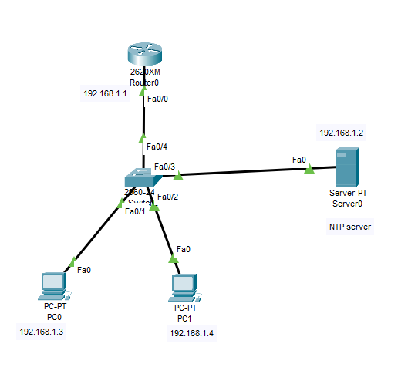
NTP (Network Time Protocol)
NTP as a separate server:
Router(config)# interface fa0/0
Router(config-if)# ip address 192.168.1.1 255.255.255.0
Router(config-if)# no shutdown
Router(config-if)# exit
Router(config)# ntp server 192.168.1.2
Result:
Router# show ntp status
Router# show ntp associations
Router# show clock

Slide 44
NTP (Network Time Protocol)
Router as NTP server:
Router# clock set 12:30:00 27 AUG 2025
Router# configure terminal
Router(config)# interface fa0/0
Router(config-if)# ip address 192.168.1.1 255.255.255.0
Router(config-if)# no shutdown
Router(config-if)# exit
Router(config)# ntp master
Router(config)# ntp server 192.168.1.1
Result:
Router# show ntp status
Router# show ntp associations
Router# show clock

Slide 45
NTP (Network Time Protocol)
Router as NTP server:
Router# clock set 12:30:00 27 AUG 2025
Router# configure terminal
Router(config)# interface s0/0
Router(config-if)# ip address 1.1.1.1 255.255.255.0
Router(config-if)# no shutdown
Router(config-if)# exit
Router(config)# ntp master
Router(config)# ntp server 1.1.1.1
Router(config)#router rip
Router(config# network 1.0.0.0
Configure IPs and routing protocol like RIP or OSPF etc. on all routers
And then configure them as NTP Client like below commands
R2(config)# ntp server 1.1.1.1
R3(config)# ntp server 1.1.1.1
R4(config)# ntp server 1.1.1.1
Router#show clock Result
NTP doesn’t care if the interface is Serial, FastEthernet, GigabitEthernet, etc.
The routers have IP connectivity between them.You configure the NTP client to point to the NTP server’s IP.

Slide 46
NTP (Network Time Protocol)
How to set Computers etc as NTP client in real and in CISCO Packet tracer
On Windows (real PC/laptop):
Go to Control Panel → Date and Time → Internet Time → Change settings.
Tick Synchronize with an Internet time server.
Enter your NTP Server’s IP (for example, your R1 router’s IP 10.0.0.1).
Click Update now → then OK.
You can also check with Command Prompt: w32tm /query /status
Cisco Packet Tracer PCs
A PC in Packet Tracer cannot sync its clock to a router.
Only Cisco routers and switches support NTP in Packet Tracer.

Slide 47
Describe DNS, SNMP Syslog , Qos , function of FTP and TFTP in a network
DNS (Domain Name System)
DNS translates domain names (e.g., google.com) into IP addresses (e.g., 142.250.182.14), allowing users to access websites without remembering numerical IPs.
SNMP (Simple Network Management Protocol)
SNMP is used to monitor and manage network devices (routers, switches, servers) by collecting performance data and sending alerts if issues arise.
Application used for SNMP:
Cisco LMS (Cisco Lifecycle Management Suite)
Cisco Prime
SolarWinds Network Performance Monitor
PRTG Network Monitor
Nagios

Slide 48
Describe DNS, SNMP Syslog , Qos , function of FTP and TFPF in a network
Syslog (System Logging Protocol)
Syslog is a protocol that records system events and logs from network devices (firewalls, routers, servers) for troubleshooting and security analysis.
Application used for Syslog:
Kiwi Syslog
SolarWinds Kiwi Syslog
Graylog
Splunk

Slide 49
Describe DNS, SNMP Syslog , Qos , function of FTP and TFPF in a network
FTP (File Transfer Protocol) Function
FTP transfers files between computers over a network.
It is used for uploading and downloading files from servers but is less secure compared to SFTP.
TFTP (Trivial File Transfer Protocol) Function
TFTP is a simpler version of FTP, used mainly for transferring configuration files to network devices (e.g., routers, switches). It lacks authentication and security.
Like when we save/restore backup of router configuration in TFTP server.

Slide 50
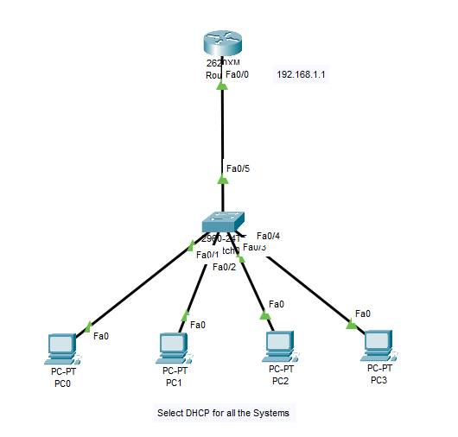
Configuration DCHP
Dynamic Host Configuration Protocl
To Assign IPs dynamically to all the systems
Router>
Router>en
Router#configure t
Router(config)#interface fa0/0
Router(config-if)#ip address 192.168.1.1 255.255.255.0
Router(config-if)#no shutdown
Router(config-if)#exit
Router(config)#ip dhcp pool CCNA
Router(dhcp-config)#network 192.168.1.0 255.255.255.0
Router(dhcp-config)#default-router 192.168.1.1
How to exclude a range of IPs
Router(config)#ip dhcp excluded-address 192.168.1.2 192.168.1.20
To exclude a single IP address
Router(config)#ip dhcp excluded-address 192.168.1.10

Slide 51
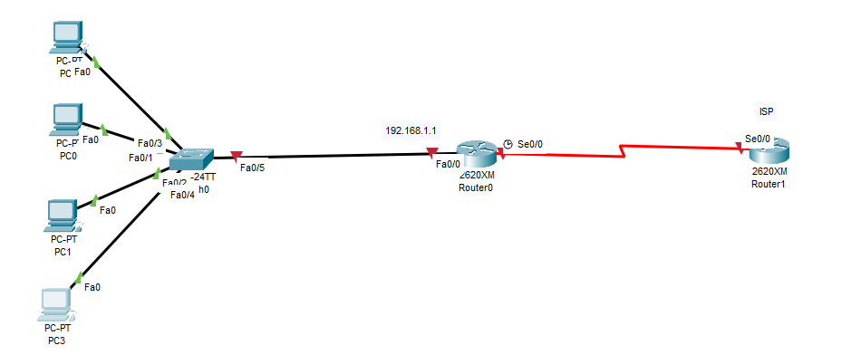
Describe the function of First hop redundancy protocol
( HSRP, VRRP, GLBP)
FHRP:
First Hop redundancy protocol
2nd Name High Availability
3rd Name Layer 3 redundancy
4th Name Gateway redundancy
Suppose we have a network and different users are connected to it
If this link is down then whole network is down
It is called single point failure

Slide 52
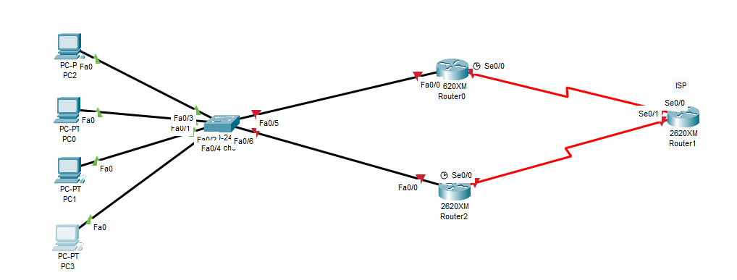
Describe the function of First hope redundancy protocol
( HSRP, VRRP, GLBP)
To solve this problem, we install a second router into the network. If one link goes down, the second link can be used.
192.168.1.3
R1
1.1.1.1
192.168.1.1
1.1.1.2
192.168.1.4
192.168.1.5
2.1.1.2
192.168.1.2
2.1.1.1
192.168.1.6
R2

Slide 53
Describe the function of First hope redundancy protocol
( HSRP, VRRP, GLBP)
But If R1 link is down then you won't be able to use R2 link because it is different gateway , so to solve this issue.
Three Protocols are used:
HSRP Hot Standby routing protocol
VRRP Virtual router redundancy protocol
GLBP Gateway load balancing protocol
These three protocols will solve the gateway IP issue.

Slide 54
Describe the function of First hope redundancy protocol
( HSRP, VRRP, GLBP)
HSRP
Can be configured on Cisco Packet tracer
192.168.1.3
255.255.255.0
192.168.1.10
R1
1.1.1.1
192.168.1.1
1.1.1.2
192.168.1.4
255.255.255.0
192.168.1.10
192.168.1.10 (Virtual IP)
2.1.1.2
192.168.1.5
255.255.255.0
192.168.1.10
192.168.1.2
2.1.1.1
R2
192.168.1.6
255.255.255.0
192.168.1.10

Slide 55
Describe the function of First hope redundancy protocol
( HSRP, VRRP, GLBP)
HSRP (Hot Standby routing protocol)
There are two roles: Active and Standby (one router will be active, and the other will be on standby).
The default priority is 100.
The router with the higher priority becomes the active router. (We can increase/decrease the priority )
Every 3 seconds, the active router sends a Hello packet to the standby router to indicate that it is active. The standby router waits for 10 seconds (hold time). If no Hello packet is received within 10 seconds, the standby router takes over as the active router.
By default, preemption is disabled in HSRP. This means that if an active router fails and the standby router takes over, the original active router will not automatically reclaim its role when it comes back online—unless the new active router goes into standby mode or a re-election occurs.
HSRP is Cisco proprietary.
HSRP uses a virtual IP address that hosts use as their default gateway.
In HSRP, routers share one common Virtual IP address.
This Virtual IP is what computers (hosts) use as their default gateway.

Slide 56
Describe the function of First hope redundancy protocol
( HSRP, VRRP, GLBP)
HSRP (Hot Standby routing protocol)
The Virtual IP is configured on both routers during HSRP setup.
But: Only the Active router actually uses it (answers ARP, sends packets).The Standby router just waits quietly.
Computers still keep sending packets to the same gateway IP (VIP) → they don’t notice the change.
In both HSRP :
The real IP is configured on the router’s physical interface (e.g., GigabitEthernet0/0).
The virtual IP (VIP) is also configured under the same interface in the HSRP configuration.
Hosts use the virtual IP as their default gateway, while the real IP is used only for router management or routing protocols.
In both HSRP:
the real IPs (physical) of the routers and the virtual IP (VIP) must all be in the same subnet.
Example:
R1 Fa0/0 (physical IP): 192.168.1.1/24
R2 Fa0/0 (physical IP): 192.168.1.2/24
Virtual IP (shared gateway): 192.168.1.10/24

Slide 57
Describe the function of First hope redundancy protocol
( HSRP, VRRP, GLBP)
Configuration of HSRP (Hot Standby routing protocol): follow the above network diagram
R1:
Router> enable
Router# configure terminal
Router(config)# interface FastEthernet0/0
Router(config-if)# ip address 192.168.1.1 255.255.255.0
Router(config-if)# no shutdown
Router(config-if)# exit
Router(config)# interface Serial0/0
Router(config-if)# ip address 1.1.1.1 255.0.0.0
Router(config-if)# no shutdown
Router(config-if)# exit
Router(config)# router ospf 30
Router(config-router)# network 192.168.1.0 0.0.0.255 area 0
Router(config-router)# network 1.0.0.0 0.255.255.255 area 0
Router(config-router)# exit
Router(config)# interface FastEthernet0/0
Router(config-if)# standby 1 ip 192.168.1.10
Router(config-if)# standby 1 priority 120
Router(config-if)# standby 1 preempt
Router(config-if)# exit
Standby 1 means HSRP group number
Or Group id
R2:
Router> enable
Router# configure terminal
Router(config)# interface FastEthernet0/0
Router(config-if)# ip address 192.168.1.2 255.255.255.0
Router(config-if)# no shutdown
Router(config-if)# exit
Router(config)# interface Serial0/0
Router(config-if)# ip address 2.1.1.1 255.0.0.0
Router(config-if)# exit
Router(config)# router ospf 30
Router(config-router)# network 192.168.1.0 0.0.0.255 area 0
Router(config-router)# network 2.0.0.0 0.255.255.255 area 0
Router(config-router)# exit
Router(config)# interface FastEthernet0/0
Router(config-if)# standby 1 ip 192.168.1.10
Router(config-if)# standby 1 preempt
Router(config-if)# exit
Result:
Router# show standby brief
Router# show standby

Slide 58
Describe the function of First hope redundancy protocol
( HSRP, VRRP, GLBP)
VRRP
Requires GNS3
192.168.1.3
R1
1.1.1.1
192.168.1.1
1.1.1.2
192.168.1.4
192.168.1.10 (Virtual IP)
192.168.1.5
2.1.1.2
192.168.1.2
2.1.1.1
192.168.1.6
R2

Slide 59
Describe the function of First hope redundancy protocol
( HSRP, VRRP, GLBP)
VRRP (Virtual Router Redundancy Protocol
Open-standard protocol.
VRRP and HSRP function similarly, but the key difference is that VRRP is open standard, while HSRP is Cisco proprietary.
The election process follows the master and backup concept.
The router with the highest priority becomes the master router.
If priorities are the same, the router with the highest IP address becomes the master.
Hello packets are sent every 1 second, with a hold time of 3 seconds.
If the master router fails, the backup router takes over after 3 seconds.
Preemption is enabled by default. If a master router goes down and later comes back online, it will automatically reclaim its role as the master.

Slide 60
Describe the function of First hope redundancy protocol
( HSRP, VRRP, GLBP)
VRRP (Virtual Router Redundancy Protocol)
VRRP defines a virtual router that is represented by a virtual IP address (VIP).
Hosts use this virtual IP as their default gateway.
If the Master fails, the Backup takes over and starts using the same virtual IP and virtual MAC, so hosts see no change.
👉 So, in configuration, you configure a Virtual IP (VIP) under the VRRP group. The "virtual router" is just the concept of this VRRP group—it does not have a separate physical entity.
In VRRP :
The real IP is configured on the router’s physical interface (e.g., GigabitEthernet0/0).
The virtual IP (VIP) is also configured under the same interface in the VRRP configuration.
Hosts use the virtual IP as their default gateway, while the real IP is used only for router management or routing protocols.
In VRRP:
the real IPs (physical) of the routers and the virtual IP (VIP) must all be in the same subnet.
Example:
R1 Fa0/0 (physical IP): 192.168.1.1/24
R2 Fa0/0 (physical IP): 192.168.1.2/24
Virtual IP (shared gateway): 192.168.1.254/24

Slide 61
Describe the function of First hope redundancy protocol
( HSRP, VRRP, GLBP)
Configuration of VRRP (Virtual Router Redundancy Protocol) : follow the above network diagram
R1:
Router> enable
Router# configure terminal
Router(config)# interface FastEthernet0/0
Router(config-if)# ip address 192.168.1.1 255.255.255.0
Router(config-if)# no shutdown
Router(config-if)# exit
Router(config)# interface Serial0/0
Router(config-if)# ip address 1.1.1.1 255.0.0.0
Router(config-if)# no shutdown
Router(config-if)# exit
Router(config)# router ospf 30
Router(config-router)# network 192.168.1.0 0.0.0.255 area 0
Router(config-router)# network 1.0.0.0 0.255.255.255 area 0
Router(config-router)# exit
Router(config)# interface FastEthernet0/0
Router(config-if)# VRRP 1 ip 192.168.1.10
Router(config-if)# VRRP 1 priority 120
Router(config-if)# exit
R2:
Router> enable
Router# configure terminal
Router(config)# interface FastEthernet0/0
Router(config-if)# ip address 192.168.1.2 255.255.255.0
Router(config-if)# no shutdown
Router(config-if)# exit
Router(config)# interface Serial0/0
Router(config-if)# ip address 2.1.1.1 255.0.0.0
Router(config-if)# exit
Router(config)# router ospf 30
Router(config-router)# network 192.168.1.0 0.0.0.255 area 0
Router(config-router)# network 2.0.0.0 0.255.255.255 area 0
Router(config-router)# exit
Router(config)# interface FastEthernet0/0
Router(config-if)# VRRP 1 ip 192.168.1.10
Router(config-if)# exit
Result:
Router# show VRRP brief

Slide 62
Describe the function of First hope redundancy protocol
( HSRP, VRRP, GLBP)
HSRP VS VRRP
HSRP
Virtual IP: Created and shared between routers.
One router = Active, another = Standby.
Computers use the Virtual IP as their default gateway.
The Active router owns the VIP and responds.
Preemption is OFF by default (router won’t take role back automatically unless enabled).
VRRP
Creates a Virtual Router (which is basically a combination of a Virtual IP + Virtual MAC).
Multiple routers form a VRRP group.
One router is Master, others are Backups.
The Virtual Router is seen by computers as the gateway.
Preemption is ON by default (if a higher-priority router comes back, it reclaims Master role).

Slide 63
Describe the function of First hope redundancy protocol
( HSRP, VRRP, GLBP)
Maximum Routers in a group
HSRP
Max routers in one group: 256 (group numbers 0–255).
But in a single group, you effectively have 1 active + 1 standby (others remain in listen state).
You can configure multiple groups (called HSRP load sharing).
👉 HSRP → usually 2 routers (1 active + 1 standby), but technically up to 256 can join the group (others just listen).
VRRP
Max routers in one group: 255 (group numbers 1–255).
In one group, you have 1 master + multiple backups.
Backups can be more than one, so failover can cascade if the master fails.
👉 VRRP → 1 master + multiple backups (up to 255 in total).

Slide 64
Describe the function of First hope redundancy protocol
( HSRP, VRRP, GLBP)
GLBP
Requires GNS3
192.168.1.3
R1
1.1.1.1
192.168.1.1
1.1.1.2
192.168.1.4
192.168.1.10 (Virtual IP)
192.168.1.5
2.1.1.2
192.168.1.2
2.1.1.1
192.168.1.6
R2

Slide 65
Describe the function of First hope redundancy protocol
( HSRP, VRRP, GLBP)
GLBP (Gateway Load Balancing Protocol)
Cisco proprietary protocol
Provides gateway redundancy and load balancing
Uses a Virtual IP for hosts as the default gateway
One router elected as AVG (Active Virtual Gateway)
Other routers become AVFs (Active Virtual Forwarders)
AVG router will be active, remaining all standby router will be AVF
AVG manages the group and assigns virtual MAC addresses to AVF and to himself
AVG has lists of all the virtual MAC addresses (Including AVG Virtual MAC and AVF Virtual MAC)
In GLBP, virtual IP will be same for all routers but virtual MAC addresses will be different
AVG has two roles , it is AVG and also AVF
Each AVF forwards traffic using its virtual MAC
AVG replies to ARP with different virtual MACs to balance traffic
If an AVF fails, another router takes over its MAC
Election is same like HSRP
Election based on priority (default 100)
Higher priority wins, if tie then highest IP
Redundancy: no single point of failure
Built in Load balancing: all routers forward traffic.
Preemption is disabled by default in GLBP

Slide 66
Describe the function of First hope redundancy protocol
( HSRP, VRRP, GLBP)
Working of GLBP:
For example,
If there are 4 packets, two packets will be sent through the active router, and the other two packets will be sent through the standby routers. In GLBP, the standby routers actively participate in forwarding traffic, balancing the load. If necessary, a standby router can become active to ensure load balancing.
One router becomes the Active Virtual Gateway (AVG).
The AVG assigns a virtual MAC address to each router in the group.
Other routers become Active Virtual Forwarders (AVFs).
Each AVF is responsible for forwarding traffic using its assigned virtual MAC.
When a host sends an ARP request for the gateway IP:
The AVG replies with a different virtual MAC address each time (using round-robin, or another load-balancing method).
Example:
1st host gets MAC of Router1 (AVF1).
2nd host gets MAC of Router2 (AVF2).
3rd host gets MAC of Router3 (AVF3).
Then it repeats.
This way, all routers can forward traffic at the same time, achieving load sharing + redundancy.
👉 In short: AVG = manager, AVFs = workers, and hosts are distributed across them in a round-robin fashion.

Slide 67
Describe the function of First hope redundancy protocol
( HSRP, VRRP, GLBP)
Working of GLBP:
👍 By default in GLBP, the load is equally distributed
GLBP Load-Balancing Methods:
Round-Robin (default):
AVG replies to each ARP request with the MAC of the next AVF in sequence.
Hosts are evenly distributed across all AVFs.
This is the one that gives equal distribution.
Weighted:
AVG assigns MAC addresses based on a weight value you configure.
Example: Router1 has weight 100, Router2 has weight 50 → Router1 will get twice as many hosts as Router2.
Host-Dependent:
A host always gets the same AVF (same MAC) for every ARP request.
Good for consistency, but doesn’t guarantee equal load distribution.
Finally:
Yes, with default (round-robin), load is equally distributed across routers. If you want unequal distribution, you use weighted mode.

Slide 68
Describe the function of First hope redundancy protocol
( HSRP, VRRP, GLBP)
Can AVG forward the traffic ?
Yes
The AVG is also one of the routers in the GLBP group.
So, while it plays the manager role (assigning virtual MACs), it can also be an Active Virtual Forwarder (AVF) at the same time.
The AVG does not forward all group traffic.
It only forwards the share of traffic that belongs to it (like any other AVF).
👉 Every ARP request for the Virtual IP goes to the AVG, and the AVG decides which AVF’s MAC to reply with.

Slide 69
Describe the function of First hope redundancy protocol
( HSRP, VRRP, GLBP)
GLBP (Gateway Load Balancing Protocol)
Example :
Routers:
R1 → elected as AVG + also an AVF
R2 → only an AVF
Virtual IP (VIP): 192.168.1.10 (used by both PCs as default gateway)
Virtual MACs:
R1 gets MAC1
R2 gets MAC2
PC1 asks: “Who has IP 192.168.1.10?” (ARP request).
AVG (R1) replies with MAC1.
Now PC1 sends all its traffic directly to R1 (AVF).
PC2 asks: “Who has IP 192.168.1.10?” (ARP request).
AVG (R1) replies with MAC2.
Now PC2 sends all its traffic directly to R2 (AVF).
Both PCs are using the same gateway IP (192.168.1.10), but their traffic goes to different routers, balancing the load.

Slide 70
Describe the function of First hope redundancy protocol
( HSRP, VRRP, GLBP)
Configuration of GLBP (Gateway load balancing protocol) : follow the above network diagram
R1:
Router> enable
Router# configure terminal
Router(config)# interface FastEthernet0/0
Router(config-if)# ip address 192.168.1.1 255.255.255.0
Router(config-if)# no shutdown
Router(config-if)# exit
Router(config)# interface Serial0/0
Router(config-if)# ip address 1.1.1.1 255.0.0.0
Router(config-if)# no shutdown
Router(config-if)# exit
Router(config)# router ospf 30
Router(config-router)# network 192.168.1.0 0.0.0.255 area 0
Router(config-router)# network 1.0.0.0 0.255.255.255 area 0
Router(config-router)# exit
Router(config)# interface FastEthernet0/0
Router(config-if)# gblp 1 ip 192.168.1.10
Router(config-if)# gblp 1 priority 120
Router(config-if)# gblp 1 preempt
Router(config-if)# exit
R2:
Router> enable
Router# configure terminal
Router(config)# interface FastEthernet0/0
Router(config-if)# ip address 192.168.1.2 255.255.255.0
Router(config-if)# no shutdown
Router(config-if)# exit
Router(config)# interface Serial0/0
Router(config-if)# ip address 2.1.1.1 255.0.0.0
Router(config-if)# exit
Router(config)# router ospf 30
Router(config-router)# network 192.168.1.0 0.0.0.255 area 0
Router(config-router)# network 2.0.0.0 0.255.255.255 area 0
Router(config-router)# exit
Router(config)# interface FastEthernet0/0
Router(config-if)# gblp 1 ip 192.168.1.10
Router(config-if)# gblp 1 preempt
Router(config-if)# exit
Result:
Router# show glbp brief

